Slide 2
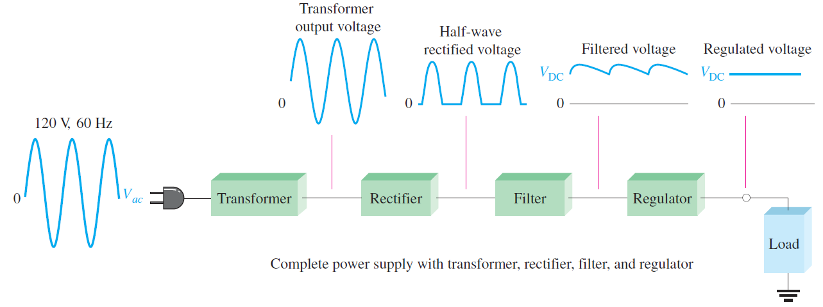
Rectifier
Rectifier is an electronic device which is used for converting an alternating quantity (Voltage or current) into unidirectional i.e. DC quantity (Voltage or current).
The input to a rectifier is AC, whereas its output is unidirectional or DC.
Every electronic circuit such as amplifiers, needs a DC power source for its operation.
This DC voltage has to be obtained from AC supply.
For this the AC supply has to be reduced,Stepped down first using a Step down transformer and then converted to dc by using rectifier.

Slide 3
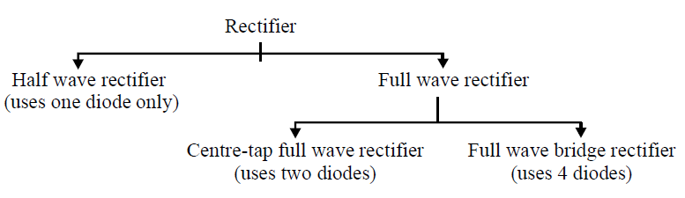

Slide 4
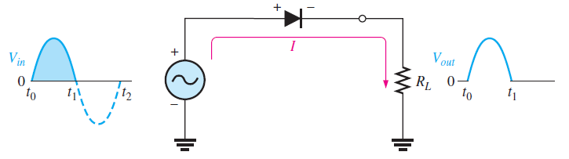

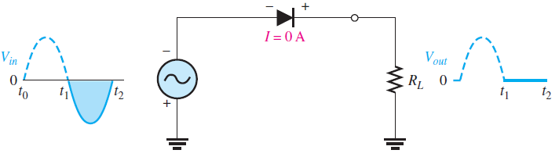
Halfwave Rectifier
A half wave rectifier is a type of rectifier which allows only half cycle (either positive half cycle or negative half cycle) of the input AC signal while the another half cycle is blocked.
If the positive half cycle is allowed then the negative half cycle is blocked.
If the negative half cycle is allowed then the positive half cycle is blocked.
A half wave rectifier will not allow both positive and negative half cycles at the same time.

Slide 5
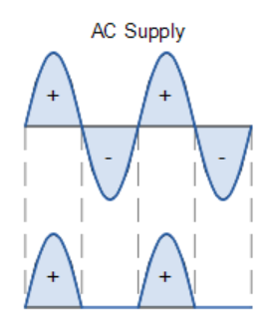
Halfwave Rectifier
Half-wave rectifier utilizes only alternate half-cycles of the input sinusoid.
For positive half cycle of input signal, Diode is forward biased & V_{o} = V_{i} .
For negaive half cycle of input signal, Diode is reverse biased & V_{o} = 0 .

Slide 6
Halfwave Rectifier

Slide 7

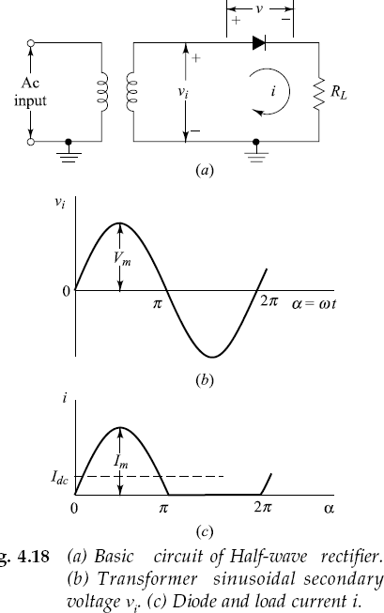



Slide 8
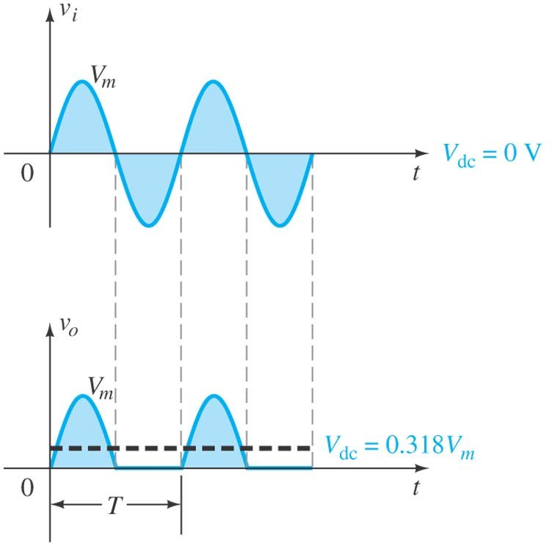

Slide 9
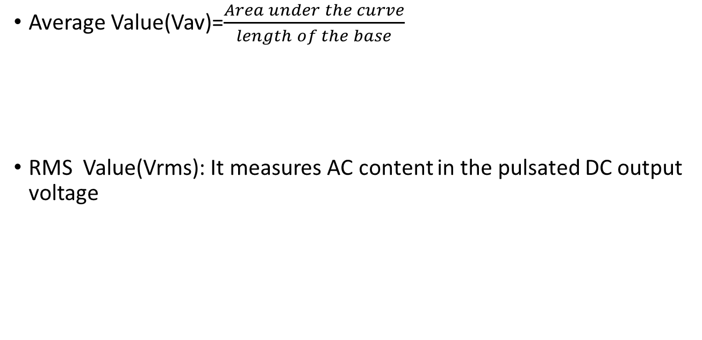

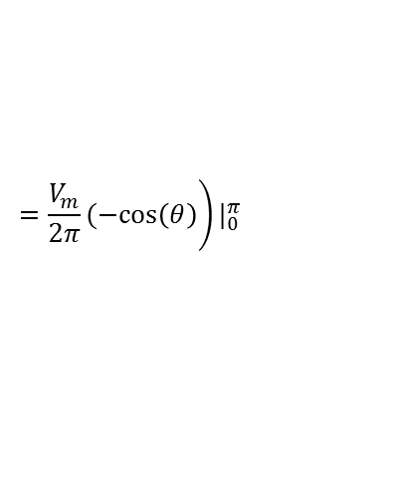



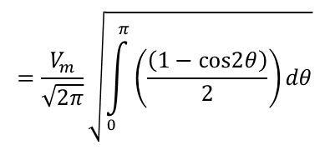
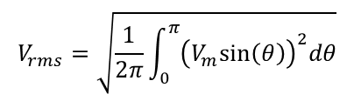

Average and RMS value

Slide 10
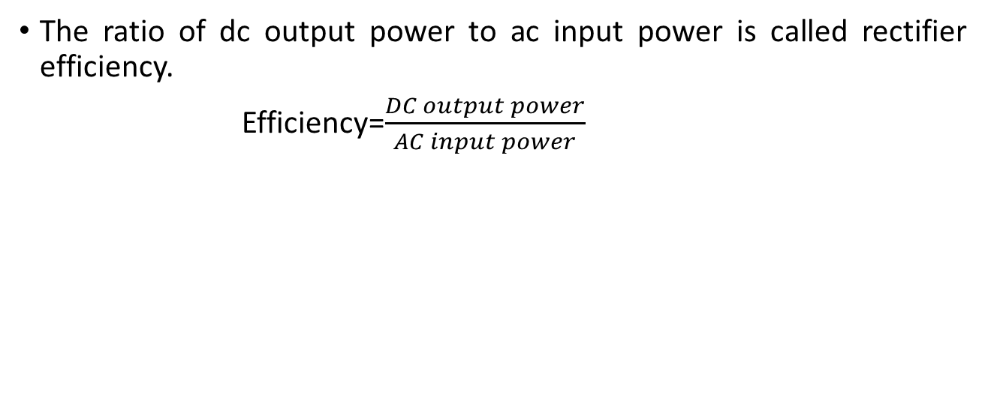





Efficiency
So efficiency of the half wave rectifier with ideal diode (r_{f}=0) is only 40.4%

Slide 11

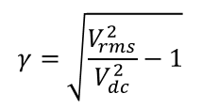
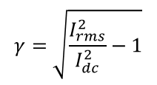
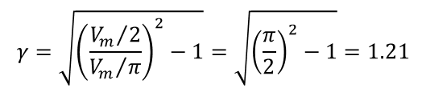
Ripple factor
It speaks about the quality of the dc output of a rectifier.
The ripple factor of a rectifier is defined as the ratio of rms value of ac component in the output to the dc component present in the output.
or
ripple factor clearly indicates that the output of a half-wave rectifier is of poor quality since it contains more ac components than the required dc components.

Slide 12
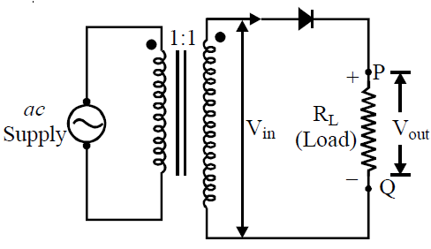
Peak Inverse voltage
It is defined as the maximum reverse voltage that a diode can withstand without destroying the junction. The peak inverse voltage across a diode is the peak of the negative half cycle. For half-wave rectifier, PIV is Vm.

Slide 13
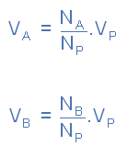
Fullwave Centertap Rectifier

Slide 14
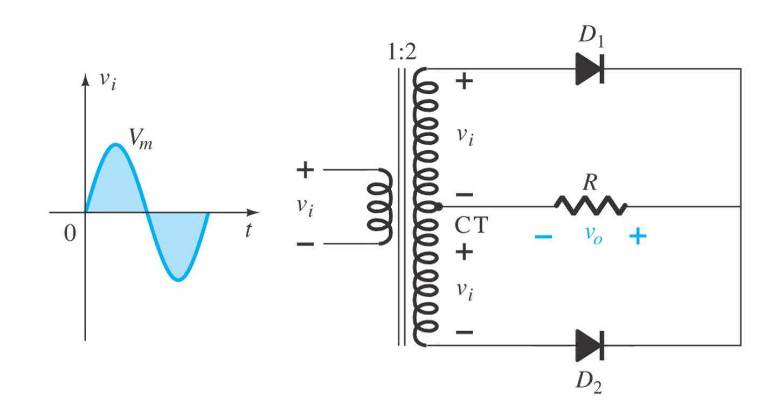
Center-tapped Transformer Full-wave Rectifier:

Slide 15
Fullwave Centertap Rectifier
During the positive half-cycle, the upper diode is forward-biased and the lower diode is reverse-biased.

Slide 16
Fullwave Centertap Rectifier
During the negative half-cycle, the lower diode is forward-biased and the upper diode is reverse-biased.

Slide 17
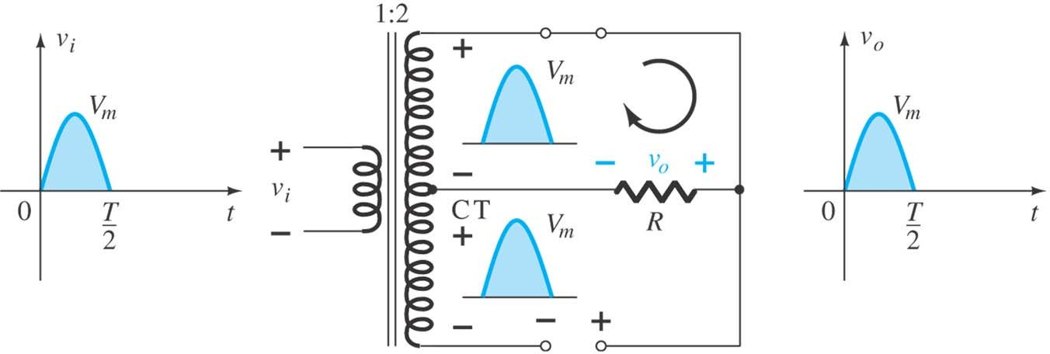
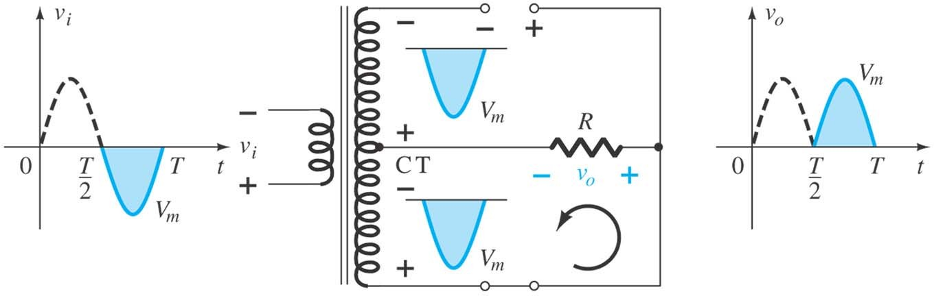
Network conditions for the positive and negative region of v_{i}.

Slide 18
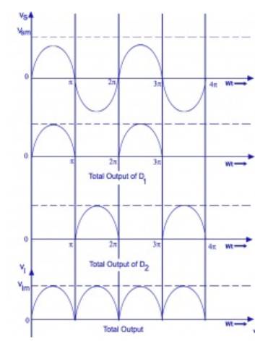
Fullwave Centertap Rectifier

Slide 19
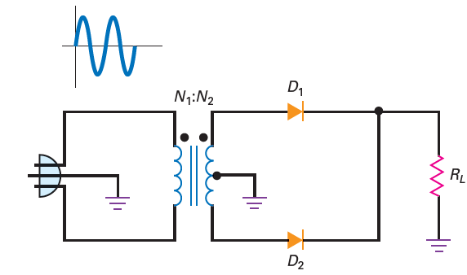
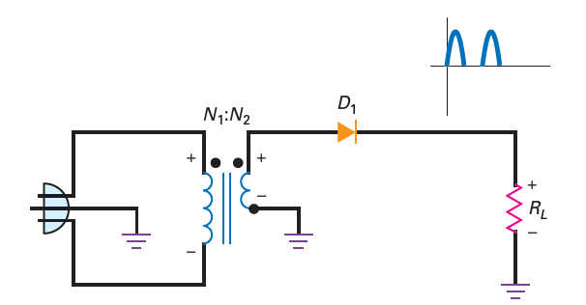
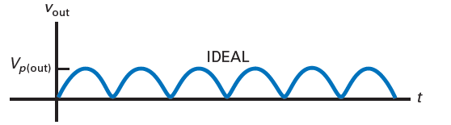
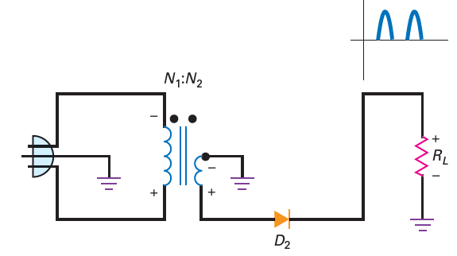

Slide 20


Peak Inverse
Voltage For each rectifier circuit
there is a maximum voltage to which the diode can be subjected. This potential is called the peak inverse voltage because it occurs during that part of the cycle when the diode is nonconducting.
For the half-wave rectifier, the peak inverse voltage is V_{m}. For a full-wave circuit, twice this value is obtained.

Slide 21
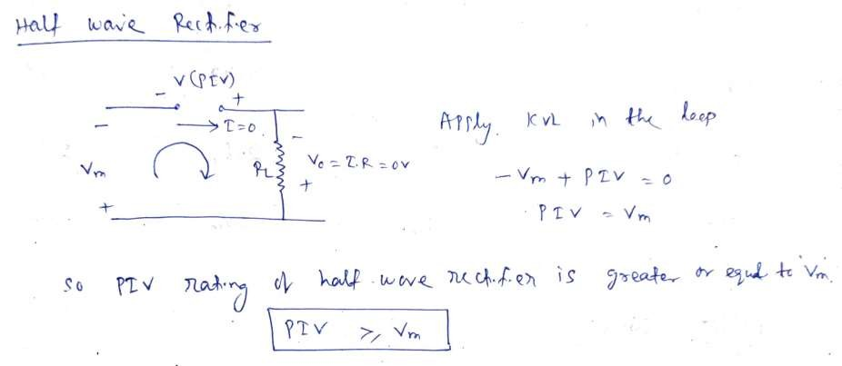
PIV of Rectifier
PIV is the maximum reverse voltage that can be applied to
the diode which will not damage the diode.
PIV rating of diode is very much important to design the circuit.
PIV of rectifier can be forund as below.

Slide 22
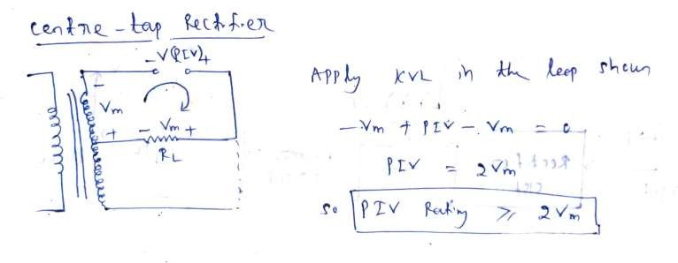
Contd...
Comparison of Rectifiers
Particulars | W.H.R | C.T.F.W.R
No. of Diode | 1 | 2
Transformer Requirement | No | Yes
Max. Efficiency | 40.6% | 81.2%
R.F | 1.21 | 0.48
Output frequency | fin | 2fin
PIV | Vm | 2Vm

Slide 23
Rectifier parameters
Average Value
RMS Value
Efficiency
Peak inverse voltage
Ripple factor

Slide 24
Rectifier parameters
Efficiency:
Rectifier efficiency indicates how efficiently the rectifier converts AC into DC.
A high percentage of rectifier efficiency indicates a good rectifier while a low percentage of rectifier efficiency indicates an inefficient rectifier.
Rectifier efficiency is defined as the ratio of DC output power to the AC input power(rms).
HWR FWR

Slide 25
Rectifier parameters
Peak inverse voltage(PIV):
Peak inverse voltage or peak reverse voltage is the maximum voltage a diode can withstand in the reverse bias condition.
If the applied voltage is greater than the peak inverse voltage, the diode will be permanently destroyed.
PIV of HWR = V_{m}
PIV of FWR = 2V_{m} (Centertapped transformer FWR)
= V_{m} (Bridgetype FWR)

Slide 26
Rectifier parameters
Ripple factor:
The ripple factor is used to measure the amount of ripples present in the output DC signal.
A high ripple factor indicates a high pulsating DC signal while a low ripple factor indicates a low pulsating DC signal.
Ripple factor is defined as the ratio of ripple voltage to the pure DC voltage.
Ripple factor of HWR is 1.21 & FWR is 0.48.

